Slide 1


Hamza: AI Personal Assistant
Submitted By
MD Parvez Mussaruf Registration No: 18502003564 Session : 2018-2019 |  | Rifatul Mostafa Registration No: 18502003593 Session : 2018-2019
Department of Computer Science and Engineering (CSE) Institute of Science and Technology (IST) 02 June, 2024

Slide 2
Content List
Introduction
Motivation
Objective
Existing System Overview
Drawbacks of Existing System
Work Flow Diagram
Level- 0 DFD
Level- 1 DFD
Use Case Diagram
Proposed System Features
Platform Overview
Implementation
Testing
Comparison
Conclusion
Future Work

Slide 3
Introduction
“Hamza: AI Personal Assistant” leverages the latest advancements in artificial intelligence and natural language processing to provide a seamless, interactive experience.
The ability to understand and respond to voice commands, Hamza can perform a wide range of tasks, from answering questions and managing your schedule to playing music and searching the web..

Slide 4
Motivation
Boost Efficiency:Hamza saves time by streamlining tasks and providing quick, accurate responses.
Natural Interaction:With advanced speech recognition, Hamza offers an intuitive, user-friendly experience.
Personalized Help:Hamza adapts to user needs with intelligent, context-aware responses for a tailored experience.

Slide 5
Objective
Automate Daily Tasks: Streamline routine activities through efficient voice commands.
Provide Seamless Interaction:Offer a user-friendly and intuitive interface with advanced speech recognition.
Deliver Personalized Assistance:Adapt to individual user needs with intelligent, context-aware responses.
Enhance Productivity:Save time and increase efficiency by managing schedules and accessing information quickly.

Slide 6
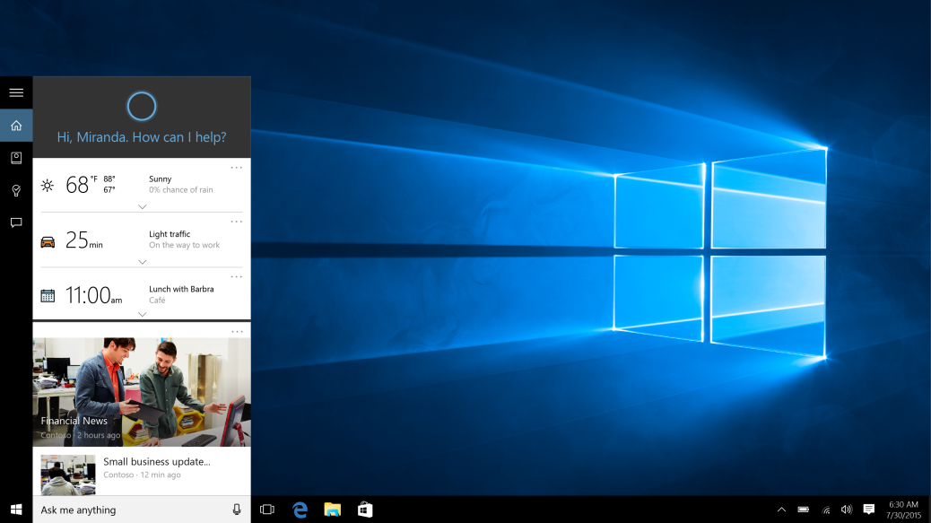
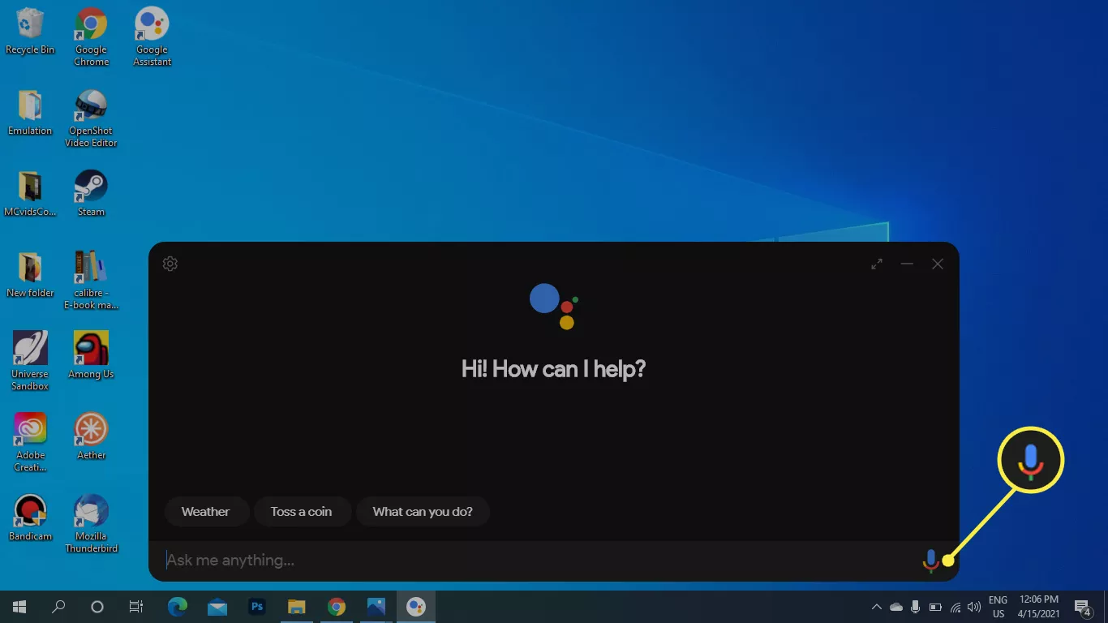
Existing System Overview
Cortana (Microsoft):
Google Assistant:

Slide 7
Drawbacks of Existing System
Primarily integrated into Windows operating systems, with limited support on other platforms. (Cortana)
Deep integration with Microsoft services but limited third-party service integration. (Cortana)
Offers some customization options, but these are relatively limited compared to open-source alternatives.(Google assistant)
Response time can be slow, especially when handling complex queries or accessing third-party services.(Google assistant)

Slide 8
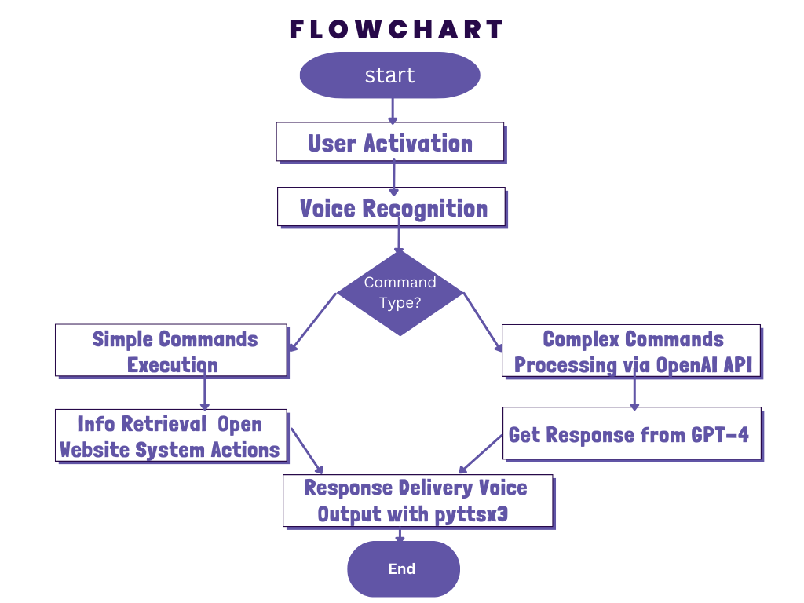
Proposed System Design
Fig: Work Flow Diagram

Slide 9
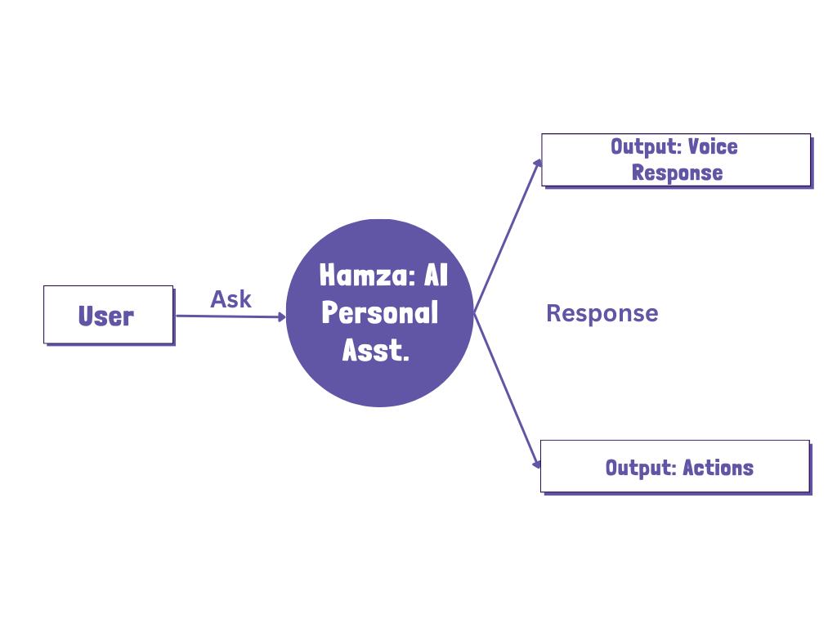
Proposed System Design
Fig: Level 0 DFD

Slide 10
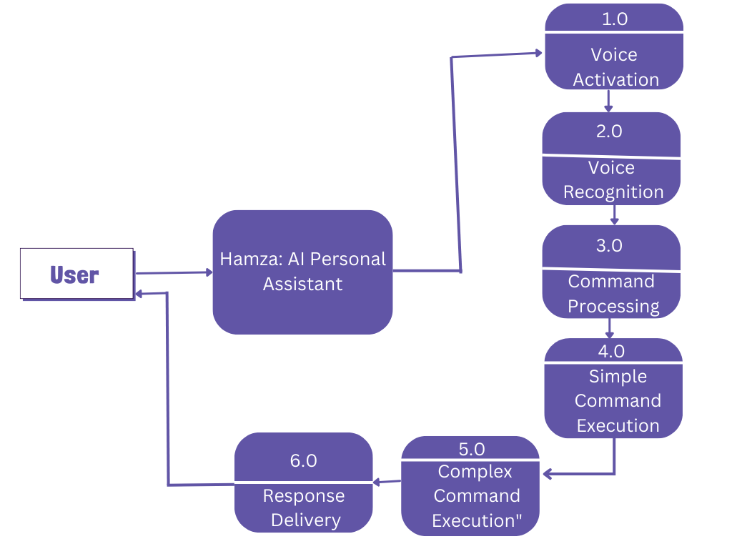
Proposed System Design
Fig: Level 1 DFD

Slide 11
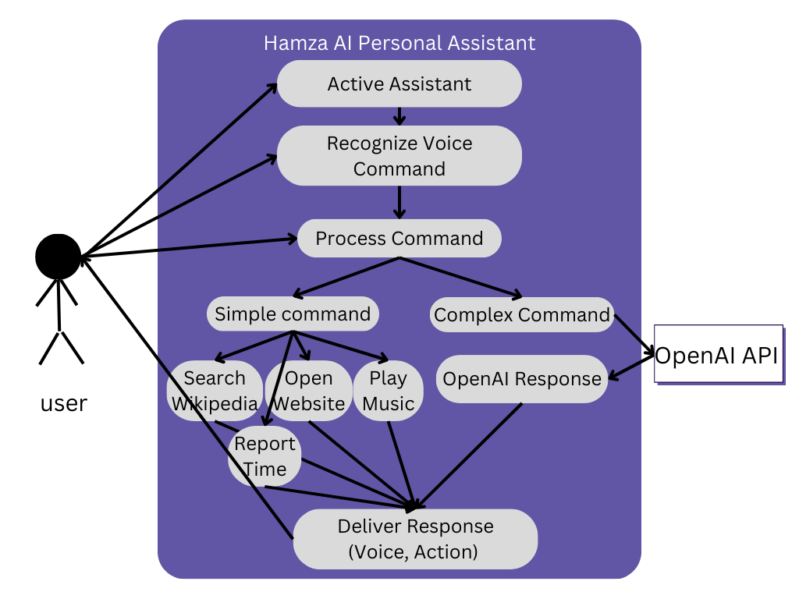
Proposed System Design
Fig: Use Case Diagram

Slide 12
Proposed System Features
Recognizes specific voice commands ("Hi, Hamza", "Hello, Hamza") to activate the assistant & Captures and processes voice commands from the user.
Determines whether the command is simple (e.g., open website, play music) or complex (e.g., natural language query).
Simple Command Execution by opening Wikipedia Search, Open Websites, Play Music, Report current Time.
For complex command uses the OpenAI API (e.g., GPT-4) to handle complex natural language queries and provide detailed responses.
Provides feedback if the voice command is not recognized or if the speech service is down.
Speaks out the response or performs the requested action.

Slide 13
Required Tools
SL | Hardware | Software
01 | OS independent | Python 3.12.3
02 | Processor Base Frequency of 1.8 GHz or higher. | Pycharm 2024.1.2
03 | 4 GB RAM or more. | OpenAI API
04 | 10 GB of available disk space or more.
05

Slide 14
Platform Overview
SL | Backend | Frontend
01 | Python | Voice Input and Output
02 | OpenAI API
03
04
05

Slide 15
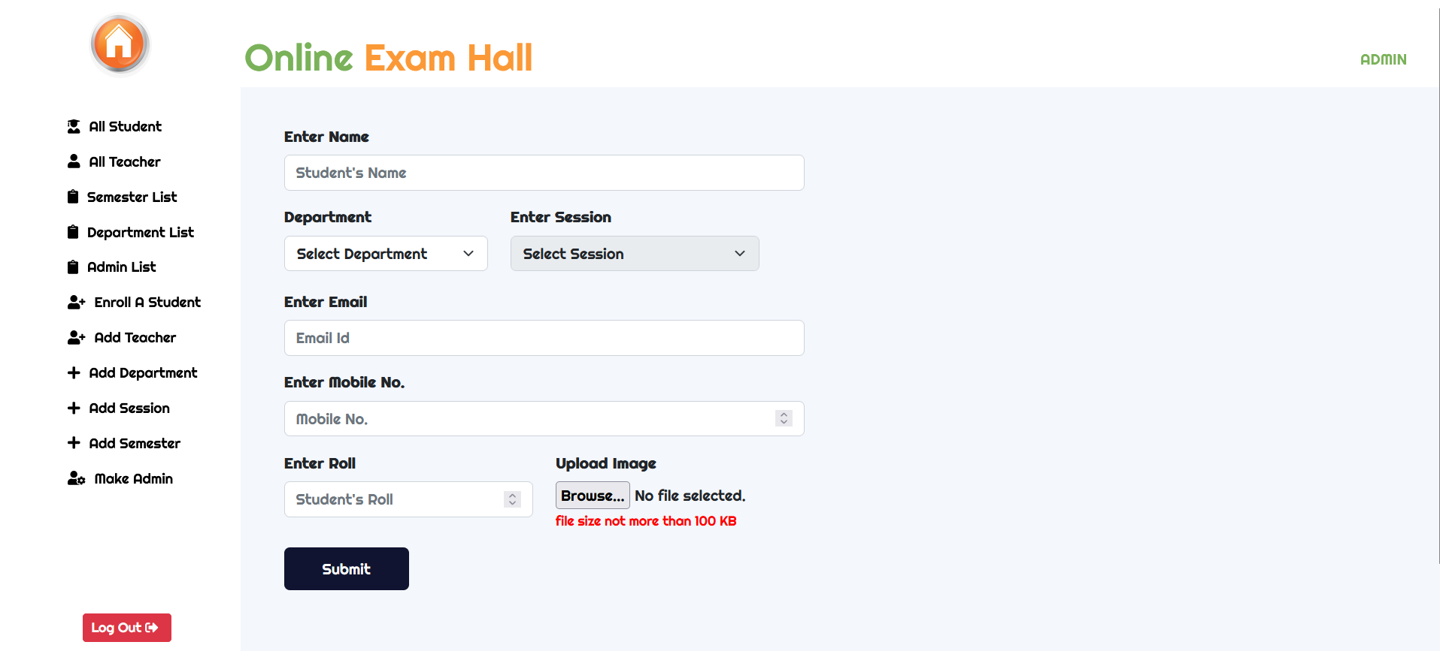
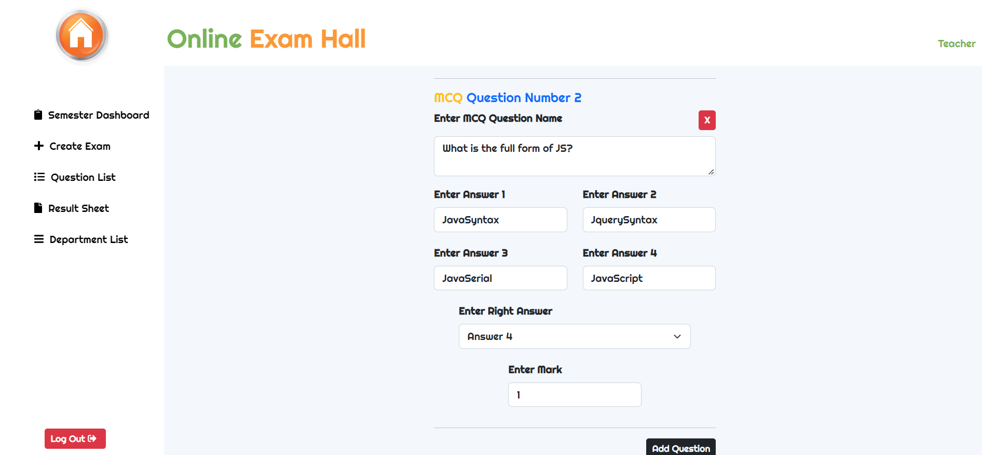
Implementation
Here we create a profile.
Fig: Profile creation page
Here we create a question.
Fig: Question creation page

Slide 16
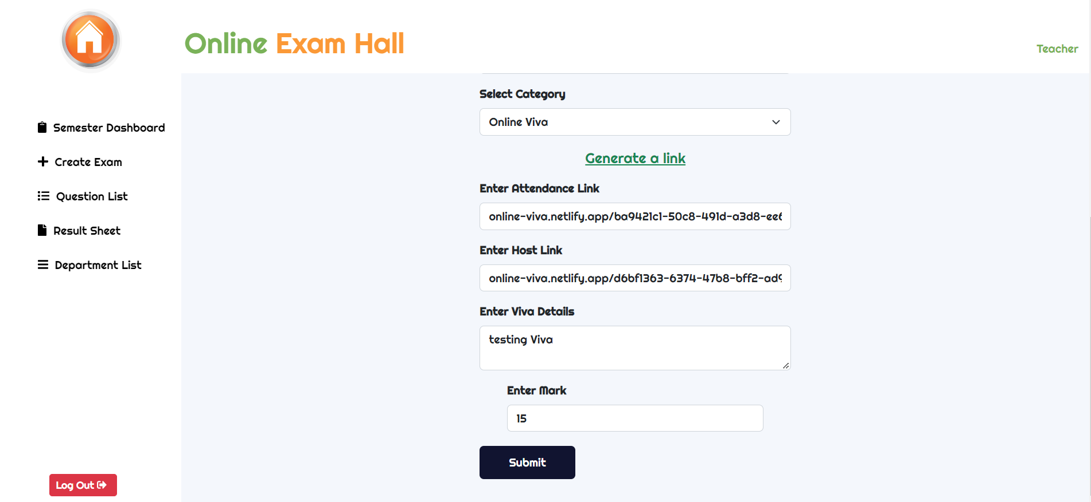
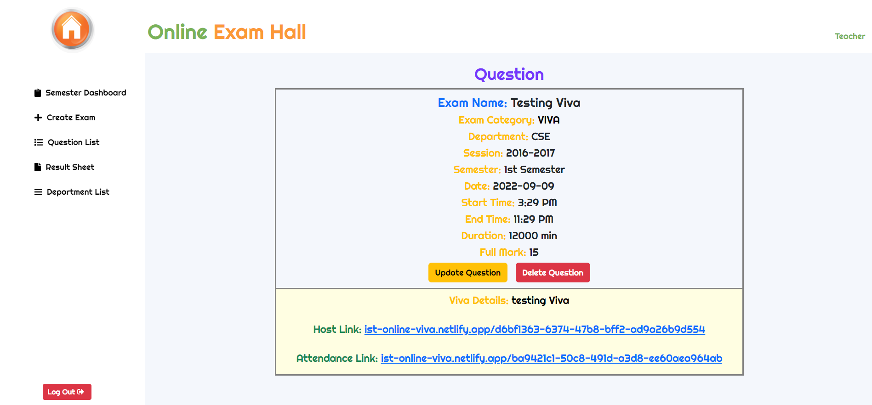
Implementation
Here we create an online viva with video calling system.
Fig: VIVA creation page
Here we can see the created viva link of video calling system.
Fig: VIVA details page

Slide 17
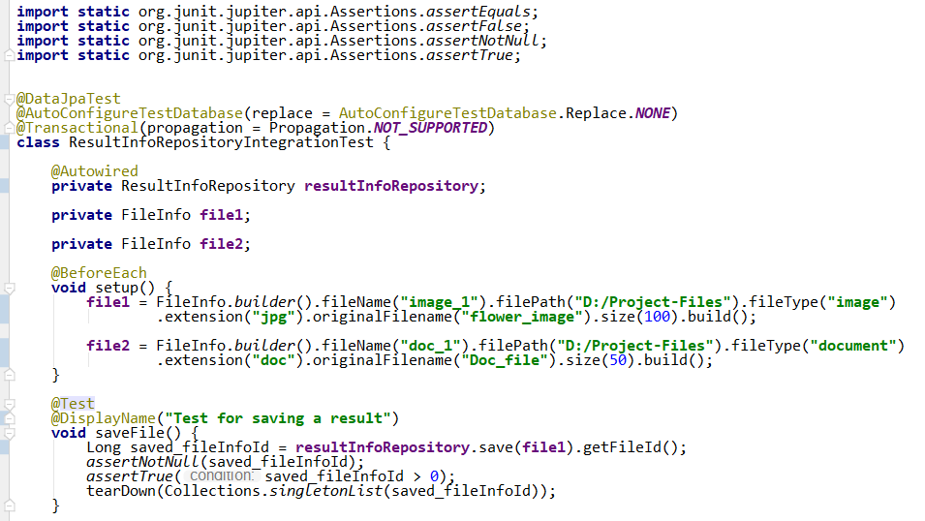
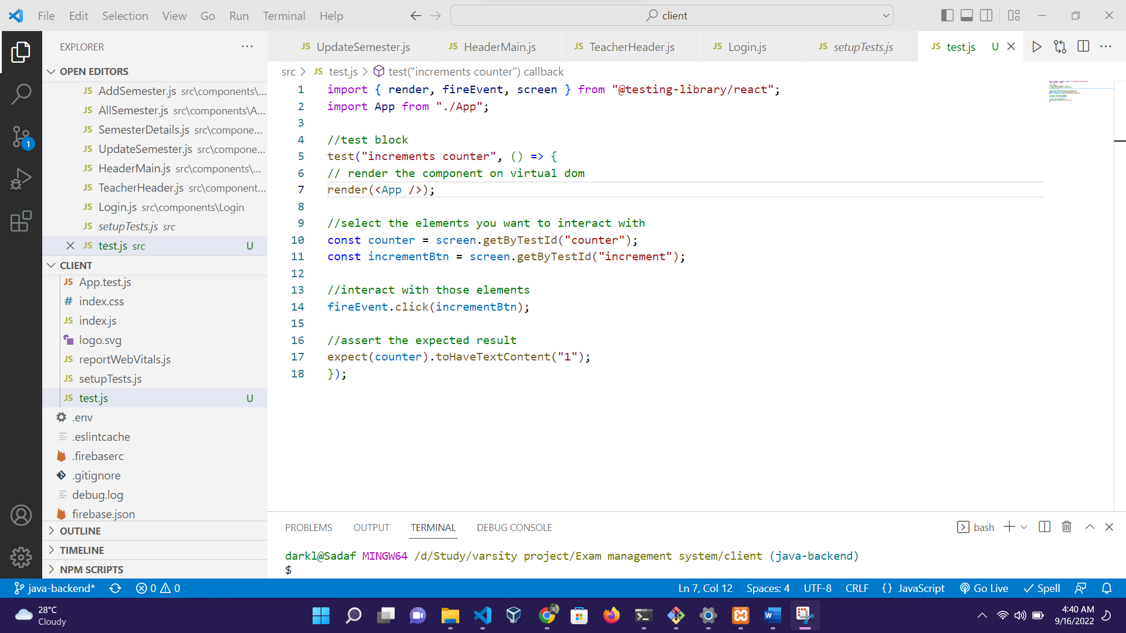
Test Result
Fig: Unit test case of Result Repository
Fig: Unit test case of App component

Slide 18
Comparison
Case | Existing Systems |  | Proposed System
 | Cortana | Google Assistant | Hamza
Voice Activation | Yes | Yes | Yes
Custom Application Integration | No | No | Yes
GPT-4 supported | No | No | Yes
Customization | No | No | Yes
Paid | No | No | No
AI integration | Yes | Yes | Yes

Slide 19
Conclusion
. Advanced AI Integration of voice recognition and natural language processing technologies for efficient personal assistance.
Complex Command Processing by engages in meaningful interactions using the OpenAI API to handle complex natural language queries.
Enhanced Productivity which simplifies daily routines, enhancing productivity and efficiency for users.
Versatile Functionality performs a variety of tasks including opening websites, searching for information, playing music, and more.

Slide 20
Future Work
Enhanced Natural Language Understanding: Implement more sophisticated natural language processing techniques to better understand and handle diverse user inputs and contexts.
Voice Personalization: Allow users to customize the assistant's voice and responses to create a more personalized interaction experience.
Machine Learning for Improved Accuracy: Utilize machine learning algorithms to continually improve voice recognition accuracy and command processing efficiency.
Offline Capabilities: Develop offline functionality for essential tasks, ensuring the assistant can operate without an internet connection.
Enhanced Security and Privacy: Strengthen security measures to protect user data and ensure privacy, especially when handling sensitive information.

